Slide 1
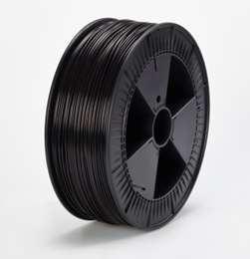
FIL-A-GEHR PC/ABS®
Filaments for professional 3D printing
Technical Data
Data based on raw material
Printing Recommendations
Tensile Test ISO 527, Interlayer Adhesion
To determine the FIL-A-GEHR PC/ABS® data, ISO 527 tensile test specimen were printed on a EVOTECH printer with the following parameters: T_{Print} 280 °C, T_{Bed} 90 °C, printing speed 55 mm/s, Slicer Simplify3D
Melt volume rate ISO 11357 260 °C / 5 kg | 18 cm³ / 10 min
Tensile Stress at Yield ISO 527 | 54 Mpa
Tensile Modulus ISO 527 | 2400 Mpa
Density ISO 1183 | 1130 kg / m³
Water absorption similar ISO 62 | 0,7 %
Drying | ca. 4 h 100-110 °C
Optimal Nozzle Temperature | 280 °C
Bed Temperature | 90 - 110 °C
Bedrock | Pertinaxplatte
Material | Orientation of test specimen (tensile bar) in build chamber | Tensile Strength | Tensile Modulus
FIL-A-GEHR PC/ABS® black | z-direction | 18,3 | 2347
FIL-A-GEHR PC/ABS® black | xy-direction | 44,7 | 2237

